Slide 1



Logistic Regression to Classify Poisonous Mushrooms
Analyses by Annalise Chang, Nicholas Way, and George Guo

Slide 2

Table of Contents
Data set introduction
Research question
Exploratory data analysis
Model fitting and comparison
Conclusions and future directions

Slide 3
Data Introduction
Data originally from Audobon Society Field Guide from 1987
Provided by UC Irvine Machine Learning Repository
Descriptions of 8124 mushrooms based on 22 characteristics
Physical features, environmental features, *poisonous or not
Poisonous: Either known to be poisonous or unknown
Not poisonous: Known to be not poisonous
Other variables categorical or binary
Mushrooms correspond to 23 species from the Agaricus and Lepiota families.
Species and family membership not included in data set
Mushroom. (1987). UCI Machine Learning Repository. https://doi.org/10.24432/C5959T.

Slide 4
Research Question: Out of certain combinations of variables, which is the best at predicting whether a mushroom is poisonous with a logistic model?

Slide 5
Exploratory Data Analysis

Slide 6
EDA Plan
Cleaning data
Original file uses unclear variable coding
Renamed and recoded according to given codebook to make data more comprehensible*
Frequencies and proportions
Investigated which variable levels in the codebook are present in the data
Plots: Faceted bar charts
Plotted the frequency of variable levels in non-poisonous vs poisonous mushrooms
Compared the groups to see if there were visible differences in variable level counts

Slide 7
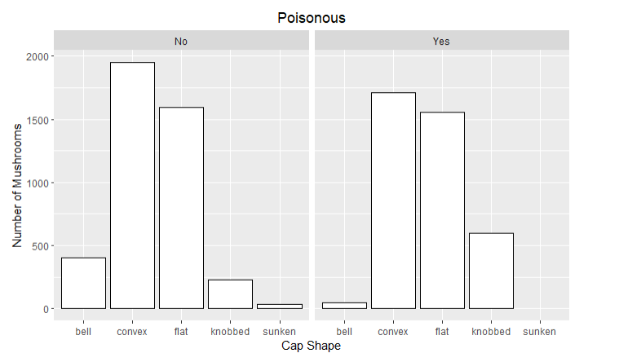

Slide 8
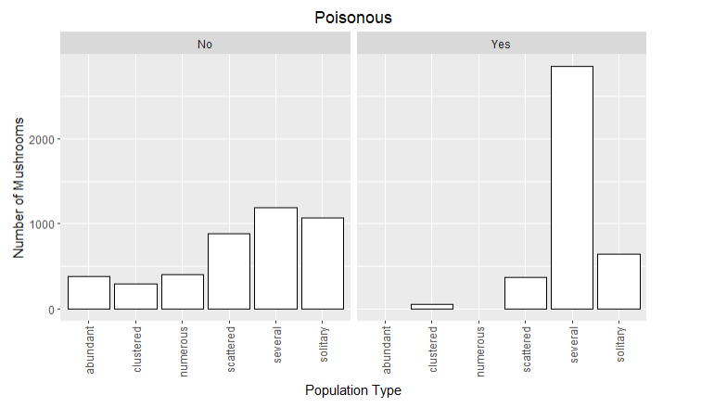

Slide 9
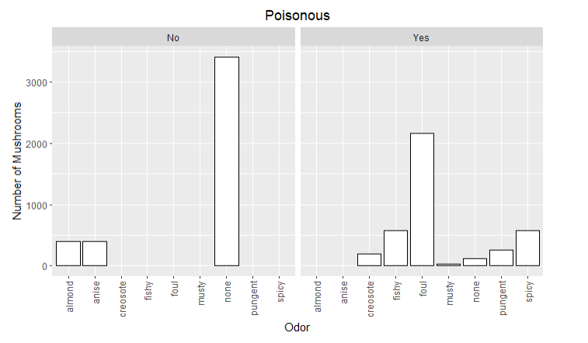

Slide 10
Model Fitting

Slide 11

Comparing Models
AIC/BIC
Model parameter likelihood comparison for non-nested models
ROC curve
Plotting sensitivity by 1 – specificity to compare area under the curve
Accuracy
Proportion of correct predictions that the model makes on the given data

Slide 12


Variable Division for Logistic Models
Cap
Shape, surface texture, color, bruising
Odor
Gills
Attachment type, spacing, size, and color
Stalk
Shape, root, surface texture above and below ring
Color below cap
Stalk color above and below ring, veil color
Rings
Number and type
Spore print
Environment
Population density and habitat

Slide 13
Comparing Models
Model | AIC | BIC | Accuracy | AUC
Cap | 7867.9 | 8000.963 | 0.806 | 0.868
Odor | -11450 | -11379.56 | 0.9852 | 0.9876
Gill | 4381.2 | 4493.247 | 0.8705 | 0.9436
Stalk | 485.87 | 558.8889 | 0.9135 | 0.965
Non-cap Color | 8317.2 | 8436.287 | 0.7676 | 0.8384
Ring | 7909.6 | 7958.58 | 0.7991 | 0.8295
Spore | 5012.1 | 5082.118 | 0.868 | 0.8983
Environment | 8279.6 | 8370.675 | 0.7543 | 0.8455

Slide 14
Conclusions

Slide 15

Conclusions from the Models
Wide range of AIC, BIC values
Many models had accuracies better than 50/50 guessing
All AUC's > 0.80
Odor model (Poisonous ~ Odor) is best model according to all parameters
Recall the faceted bar plot from the exploratory data analysis...

Slide 17


Limitations and Future Directions
Data set limitation: All variables were categorical or binary
How could quantitative variables impact modeling?
Potential quantitative variable: size measurements
Future directions
Newer data set: changes since 1987?
Different mushroom families, locations, etc.

Slide 18
Logistic Regression to Classify Poisonous Mushrooms
Analyses by Annalise Chang, Nicholas Way, and George Guo

